Slide 1
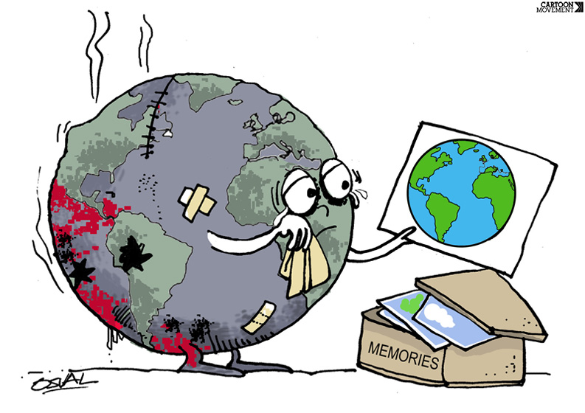
Won’t you please lend a helping hand
Pamela Teves
Brandman University

Slide 2
First…
In an effort to make California better, we need to work together.
To work together, we need to be on the same page.
To be on the same page, we need to know the same definitions.

Slide 3
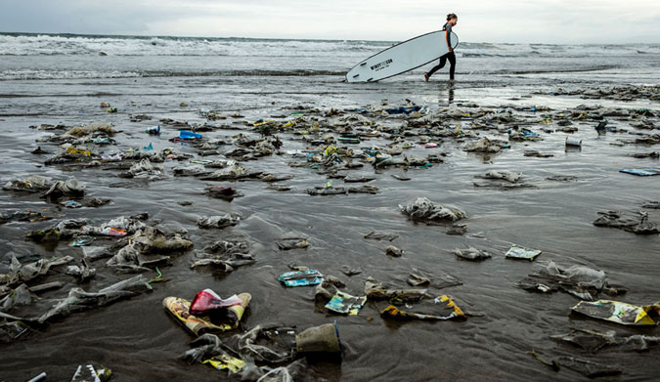
Pollution
The introduction of a substance that is harmful or has a negative effect
Blickley, L. (2015) https://www.theinertia.com/environment/california-deals-a-major-blow-to-plastic-pollution/

Slide 4
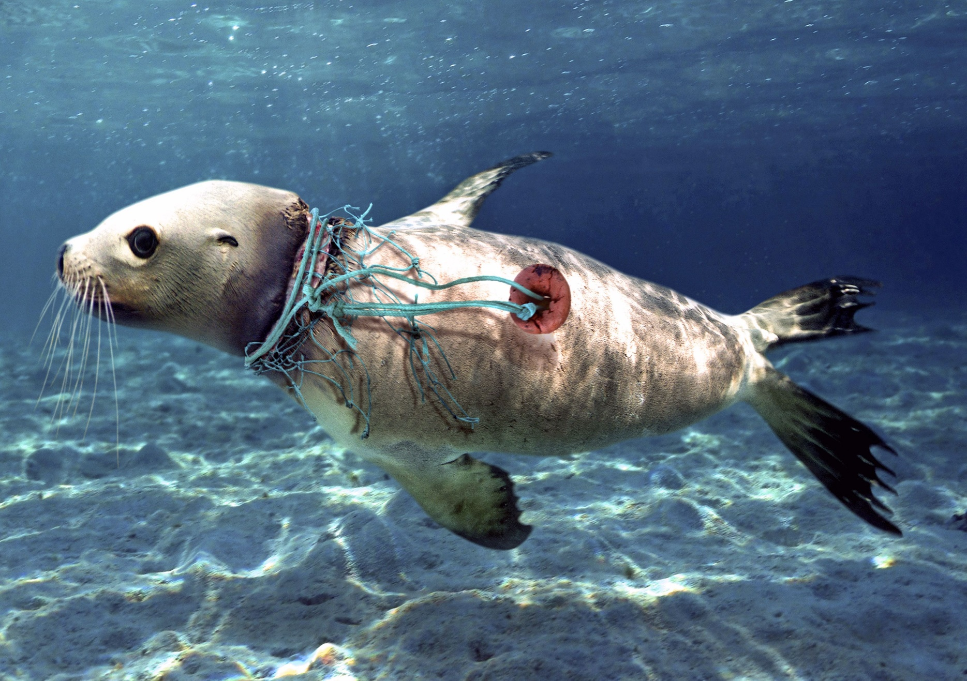
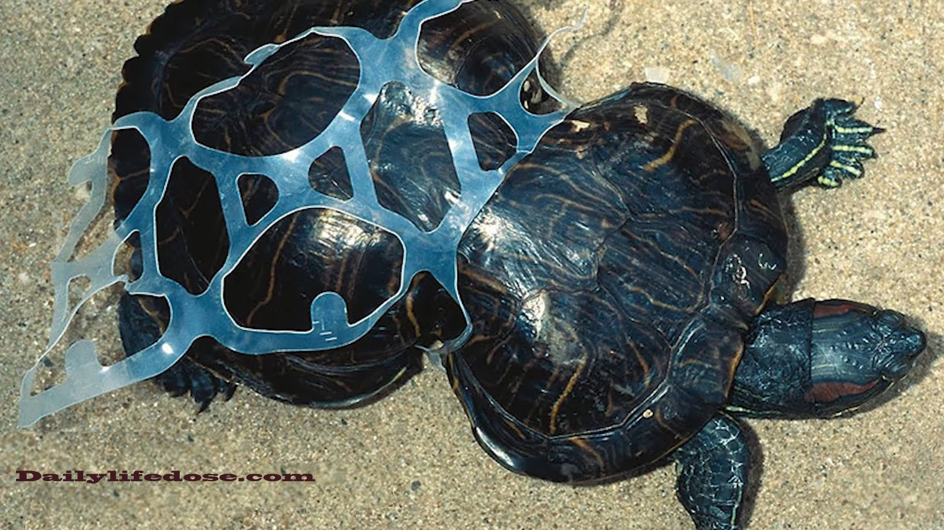
Pollution may begin as a single item, but it can be deadly to all beings which live on Earth.
Oliviera (2018) https://www.yahoo.com/news/disturbing-composite-photos-reimagine-ocean-slideshow-wp-184651080.html
Lisa, A. (2013) https://inhabitat.com/peanut-the-story-behind-the-poor-sea-turtle-deformed-by-a-six-pack-ring/

Slide 5
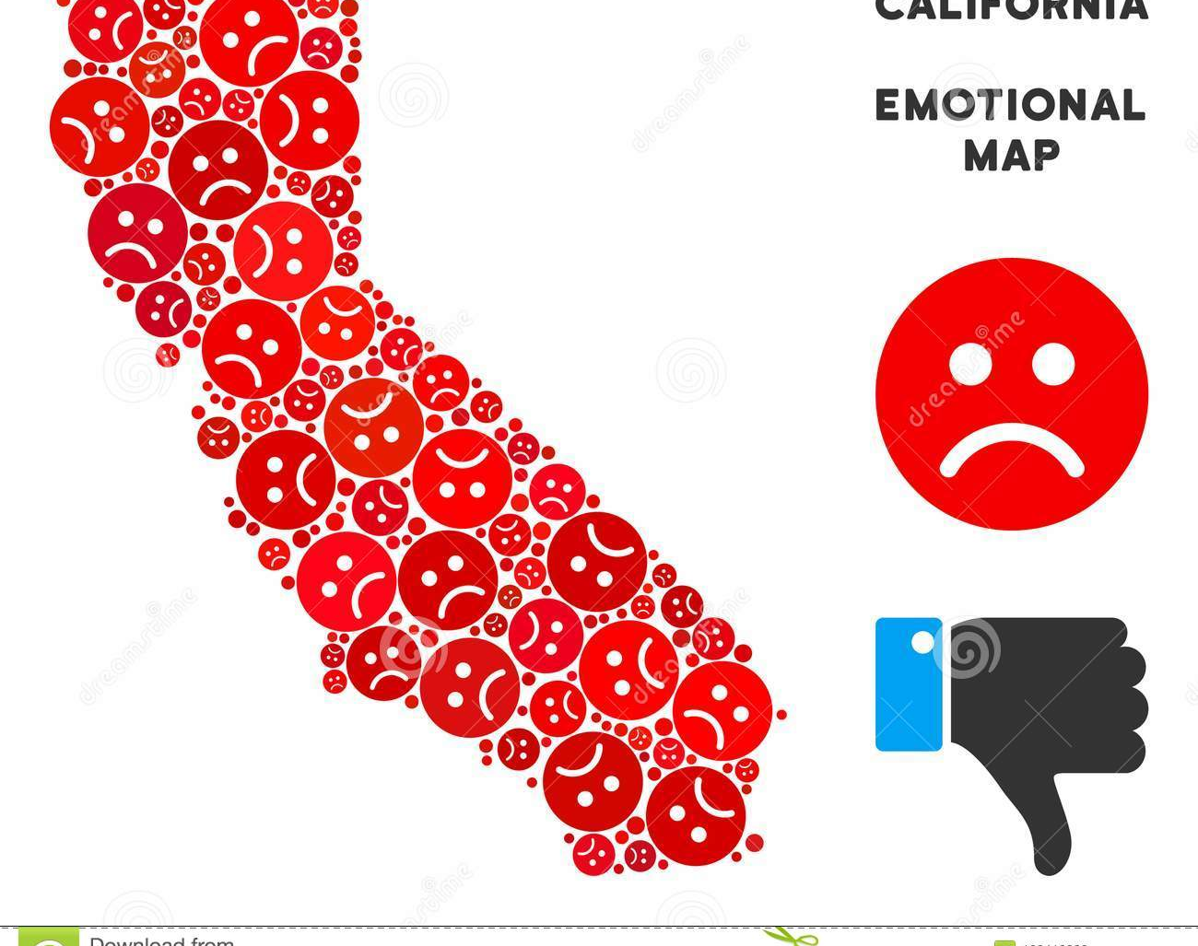
We can pollute anything and everything
Air
Land
Water
Animals
Ourselves
Each other
https://www.dreamstime.com/vector-emotional-california-map-collage-sad-emojis-sorrow-composition-smileys-red-colors-negative-mood-concept-crisis-image120410303

Slide 6
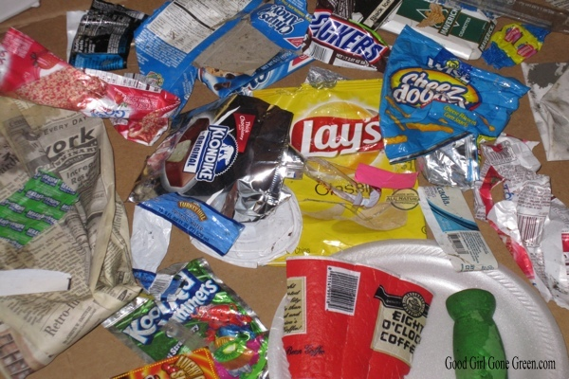
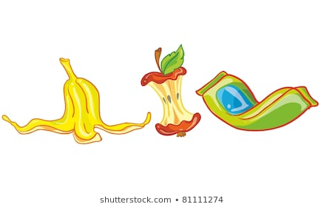
What is garbage?
A thing that is considered useless or no longer needed.
GoodGirl (2019) https://www.goodgirlgonegreen.com/i-dont-understand/
Katrina.Happy (n.d.) https://www.shutterstock.com/image-vector/vector-illustration-set-garbage-81111274

Slide 7
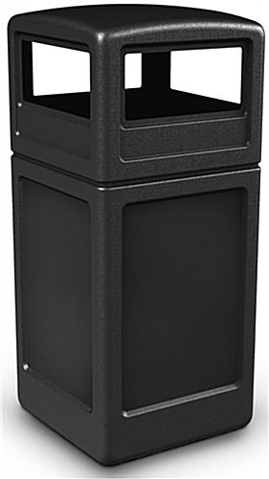
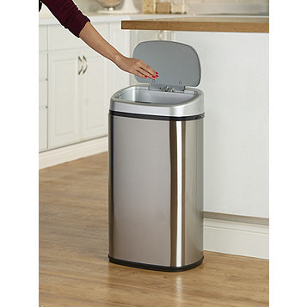
Where should we put the garbage when done with it?

Slide 8
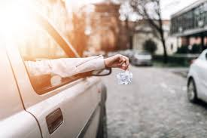
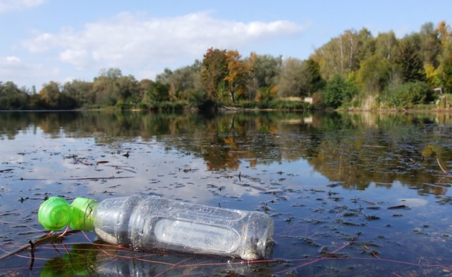
What do we NOT do with our garbage?
Elsom, D. (2019) https://www.thesun.co.uk/motors/5947930/drivers-150-fine-litter-passenger-rubbish/
Reeves (2015) https://www.alternativesjournal.ca/community/blogs/current-events/cost-great-lakes-plastic-clean

Slide 9
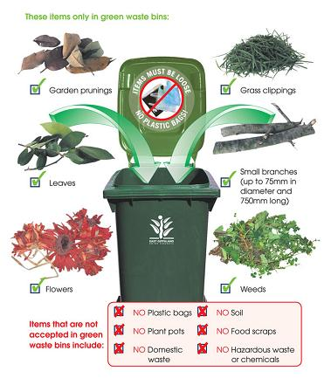
What is Green Waste?
Organic stuff that can be broken down
Egipps (n.d.) https://www.eastgippsland.vic.gov.au/Services/Waste/Organic_Waste_Services

Slide 10
What is Recycling? Benefits of Recycling?
Converting waste into something else
Recycling reduces the waste sent to landfills
It conserves natural resources and prevents further pollution which occurs when producing a raw natural resource
What????

Slide 11
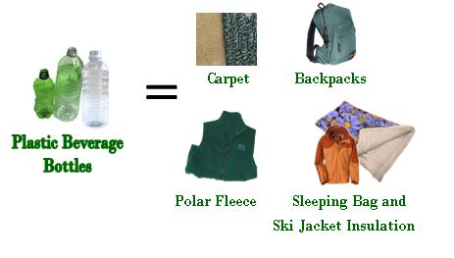
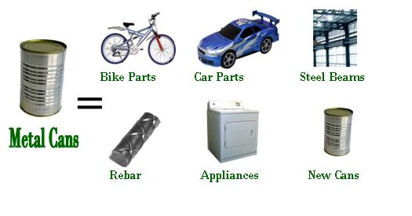
It turns used stuff into new stuff
Maine.gov (2019) https://www.maine.gov/dep/waste/recycle/whatrecyclablesbecome.html

Slide 12
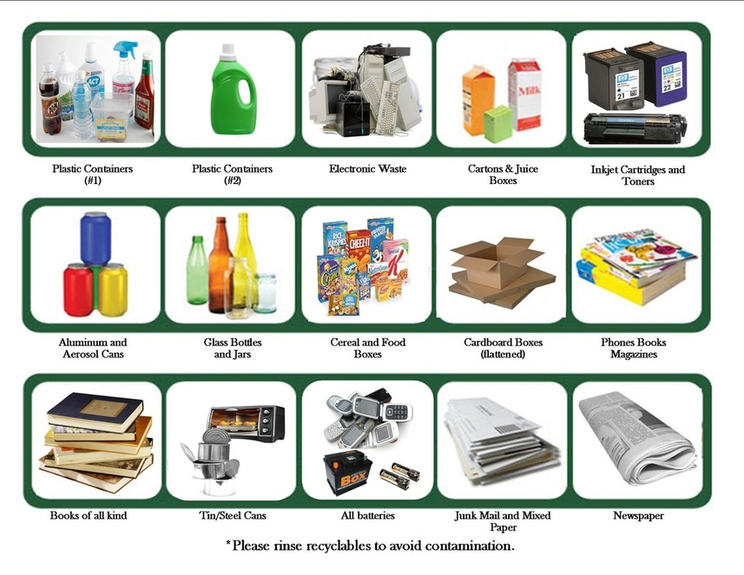
We can recycle all sorts of things
Smart Health Talk (2012) http://www.smarthealthtalk.com/recycled-products.html

Slide 13
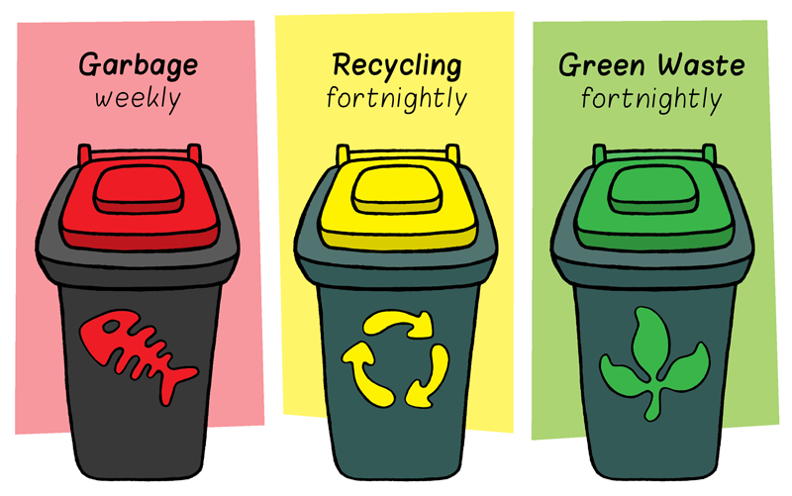
There are bins for all three – Please use them
PNG Library (2018) https://i-love-png.com/recycle-bin-png-picture_16144.html

Slide 14
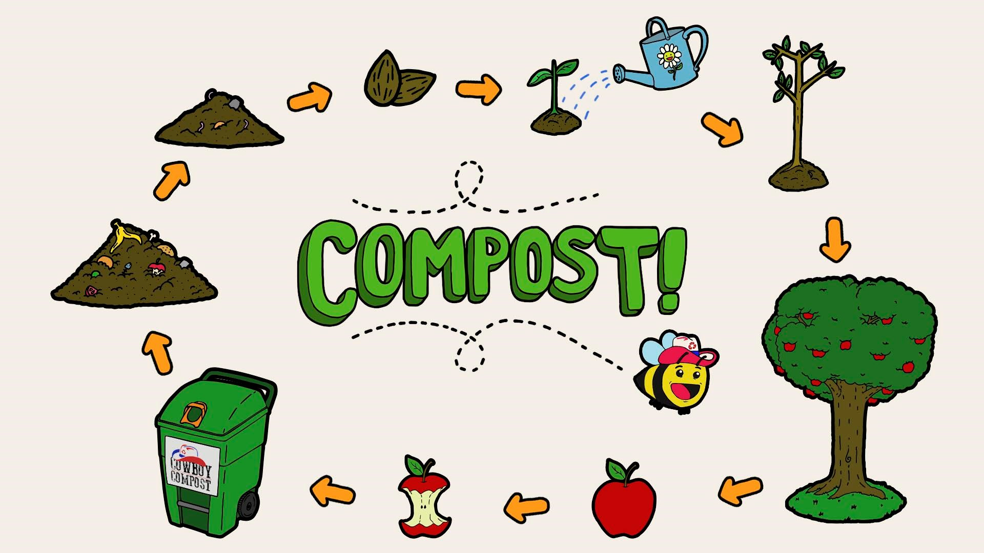
Have you ever heard of compost?
Compost is nature’s way of recycling

Slide 15
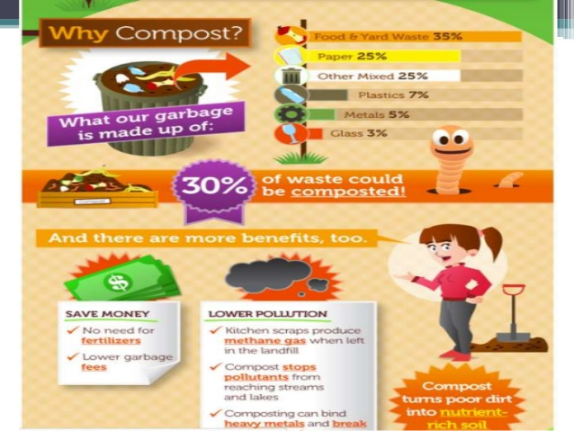
Sakshi (2019) https://pt.slideshare.net/SakshiTiwari3/compost-and-composting-techniques/3

Slide 16
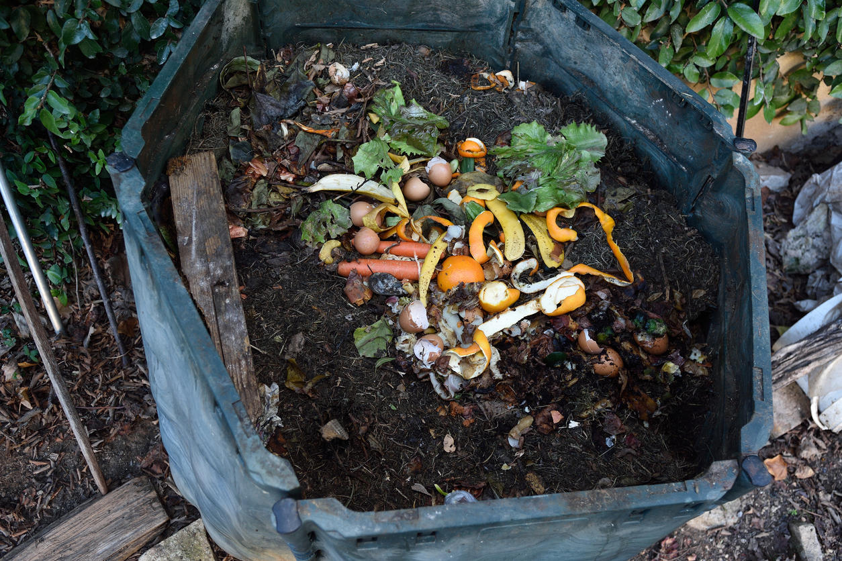
40% of the waste in landfills could have been composted
Williams, S. (2019) Green Waste Article

Slide 17

That was a lot of information.
Let’s see how much you remember. Thumbs Up if the person is being a good Californian or Thumbs Down if the person is making a bad choice.
Leader (2019) https://www.riverinaleader.com.au/story/5869791/thumbs-down-to-roadside-dumping-grounds/

Slide 18
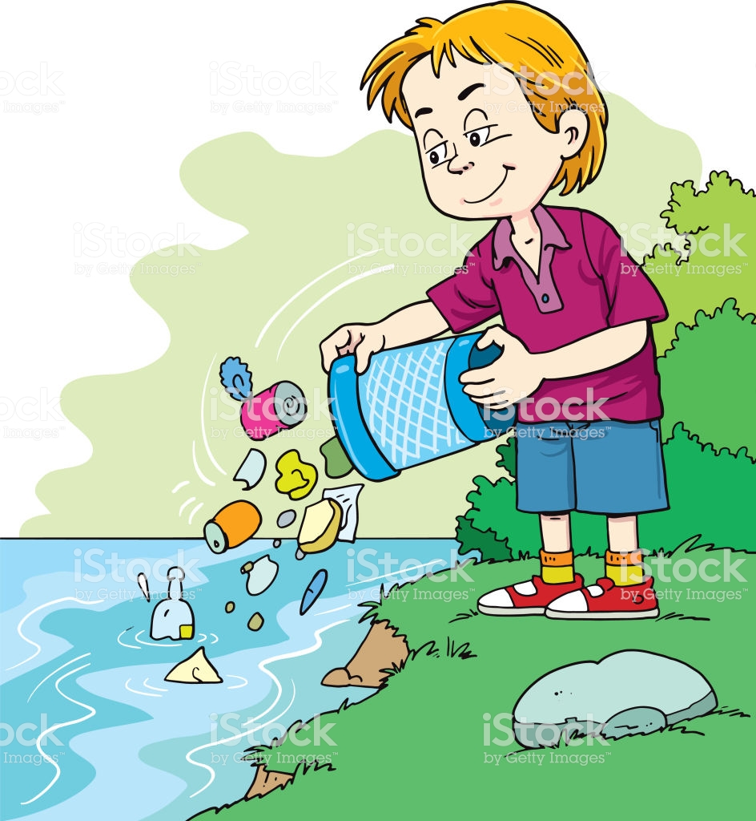
Zarism (2018) https://www.istockphoto.com/vector/child-throws-a-garbage-in-the-river-gm918106158-252561008

Slide 19
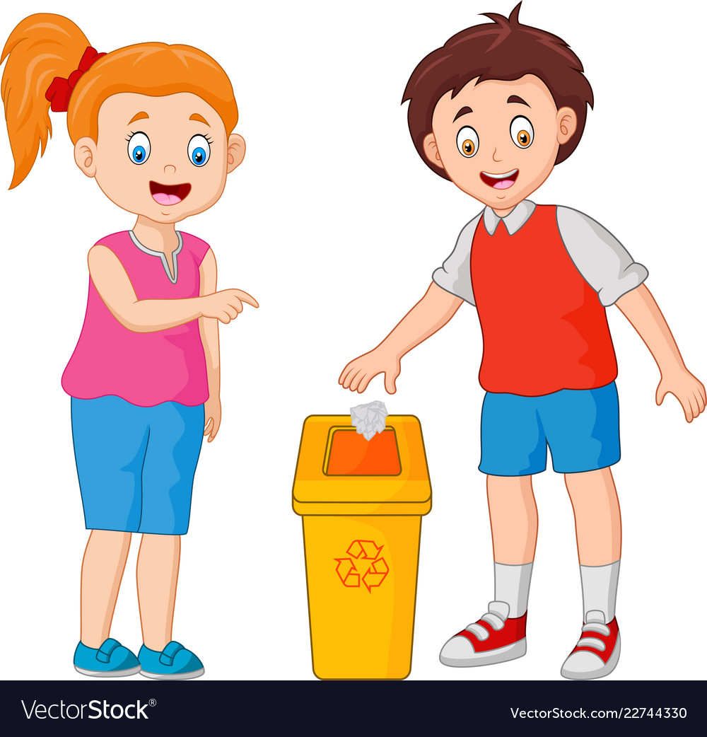
Segoviadesign (n.d.) https://www.vectorstock.com/royalty-free-vector/kid-throws-garbage-in-the-trash-vector-22744330

Slide 20
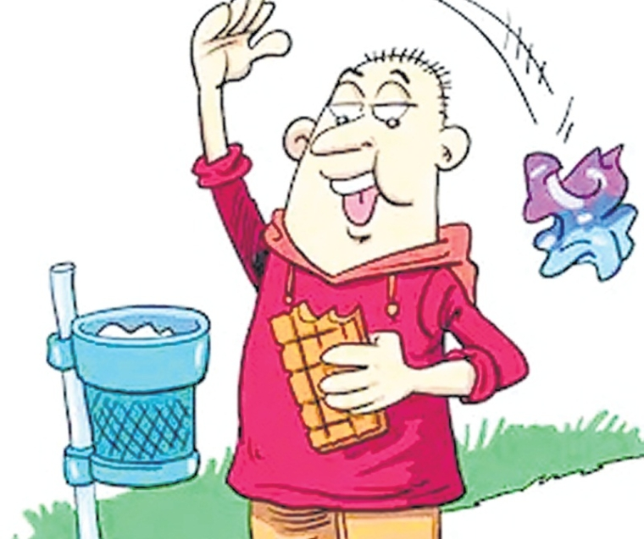
Mumbai (2019) https://www.freepressjournal.in/mumbai/brihanmumbai-municipal-corporation-collects-294-lakh-as-fine-from-people-throwing-garbage-in-gutters

Slide 21
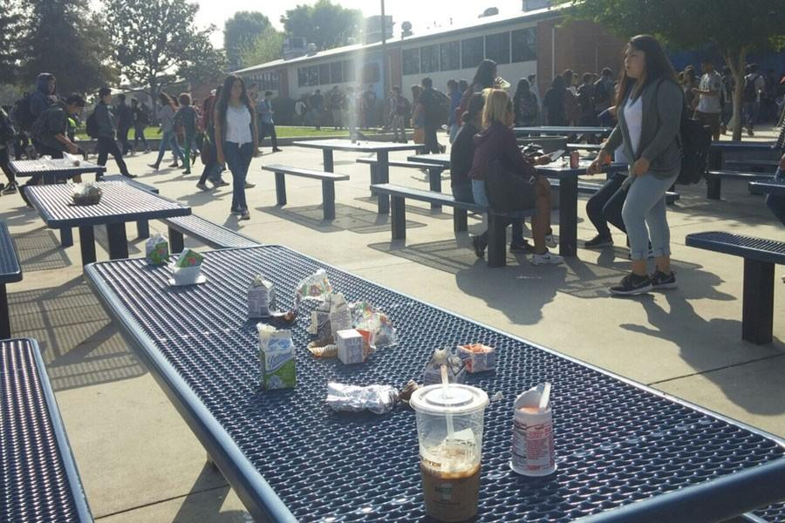
Jimenenz (2016) https://bphsvanguard.com/3908/archives/are-we-in-a-landfill-or-is-this-a-high-school-campus/

Slide 22
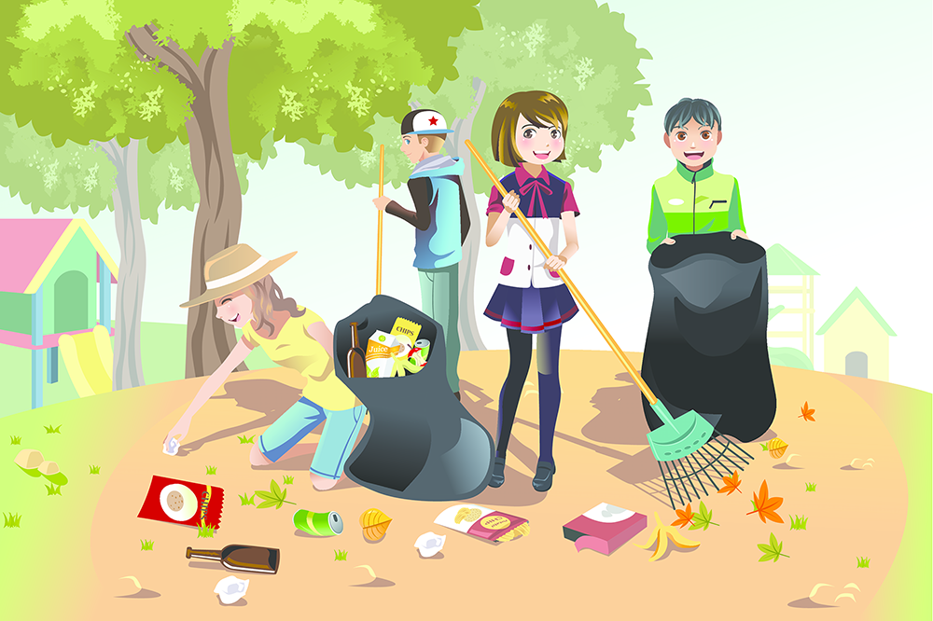
Solhail (2017) https://medium.com/@MahnoorSohail/keep-the-world-clean-it-starts-with-you-91885f1b57f7

Slide 23
Fantastic!
You have made me very happy that you now know what you should do with your garbage. Please tell your friends and family.

Slide 24
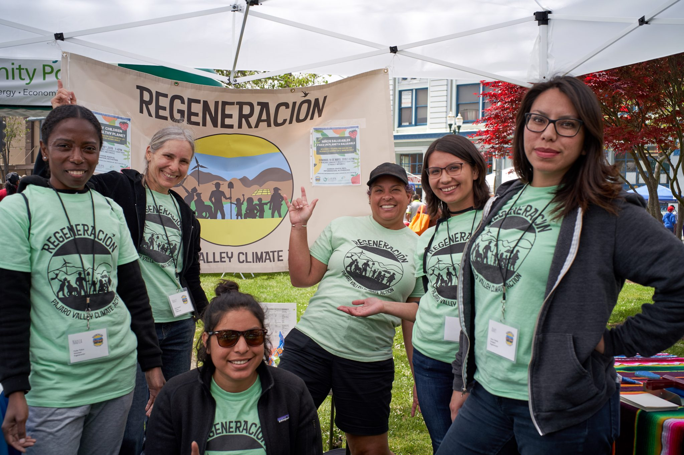
Cal EPA (2019) https://calepa.ca.gov/
If you would like to continue in your efforts to help, the California Environmental Protection Agency (EPA) is a great place to start.

Slide 25

Together, we can make a difference.
iKandy (n.d.) California Map Character. https://www.shutterstock.com/image-vector/california-map-character-92367619

Slide 26
Resources
Cal EPA (2019) Retrieved from https://calepa.ca.gov/about/
Williams, S. R., Zhu-Barker, X., Lew, S., Croze, B. J., Fallan, K. R., & Horwath, W. R. (2019). Impact of Composting Food Waste with Green Waste on Greenhouse Gas Emissions from Compost Windrows. Compost Science & Utilization, (1), 35. Retrieved from http://search.ebscohost.com.libproxy.chapman.edu/login.aspx?direct=true&AuthType=ip, uid&db=edsbl&AN=vdc.100081942659.0x000001&site=eds-live

